Slide 1
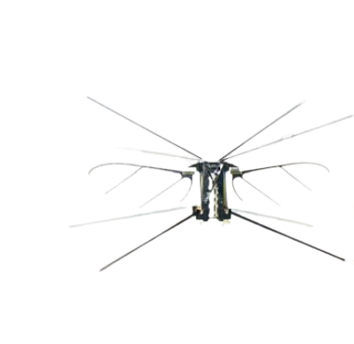
CHAPTER 3
Wing Inertia and Morphology
Influence on Aerodynamic Performance of Flapping-Wing MAVs
Anoop Patel
Intern | Mechanical Engineering
NIT Sikkim
Guide
Dr Sai Sidhardh
08 June 2026

Slide 2
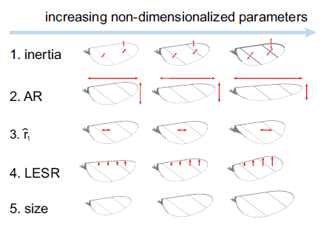
INTRODUCTION
Background & Motivation
What are Micro Air Vehicles (MAVs)?
Insect-scale robots that use flapping wings for lift and thrust.
The RoboBee Platform
Developed at Harvard Microrobotics Lab. Mass ≈ 80 mg.
Why wing morphology matters?
Wing geometry directly governs resonance frequency, pitch amplitude, lift generation, and power consumption.
Our Aim Improving the robot’s flapping performance and thus payload capacity.
We demonstrate that wing morphology has large impact on lift enhancement.
Figure 3.1: Wing driver platform and wing designs.
Goal of Chapter 3: Systematically quantify how 5 wing parameters affect lift, power, and resonance frequency.

Slide 3
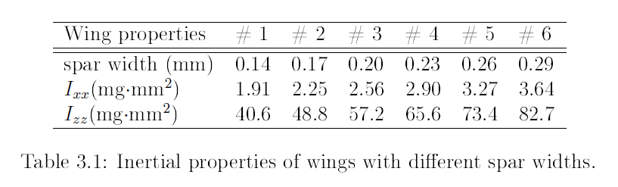
PARAMETER 1
Wing Inertia
Key Finding: An intermediate inertia (not minimum) gives maximum lift. This is because inertia governs pitch amplitude .
mspar = ρ * Vspar
mspar = ρ * L*t*W
I = ʃ r^2 * dm

Slide 4
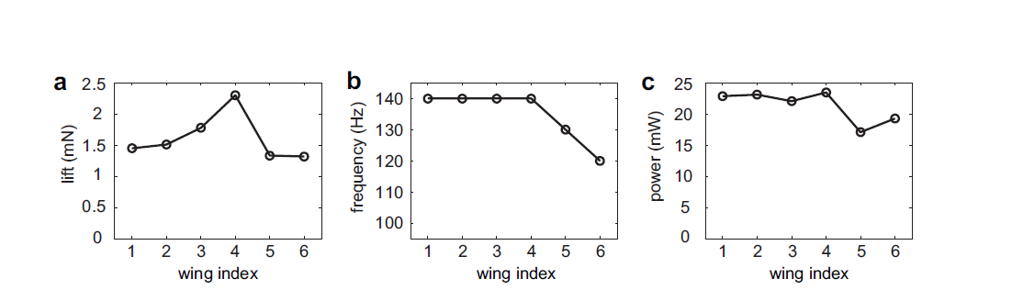
Figure 3.2: Wing inertia influence on aerodynamic performance, stroke and pitch kinematics.
By quasi-steady model
CL ∝ sin(2α) = cos(2ψ) [α=angle of attack]
Wing 4 has largest pitch amplitude ψmax [ψmax increases as the wing intertia increases]

Slide 5
PARAMETER 2
Wing Aspect Ratio
Aspect Ratio = Span / Chord (range tested: AR = 3.0 → 5.5)
Lift/frequency/power Vs AR
As the AR increases the lift, frequency and power dissipated decreases.
Max lift at AR=3.5 instead of AR=3
Because the resonance frequency of AR=3 is expected to be higher than 140 Hz.
Resonance Frequency Vs AR
The resonance frequency is decreasing because the chordwise moment of inertia is increasing.
Ixx vs Izz
Chordwise moment of inertia(Izz) increases and the spanwise moment of inertia(Ixx) is decreases.

Slide 6
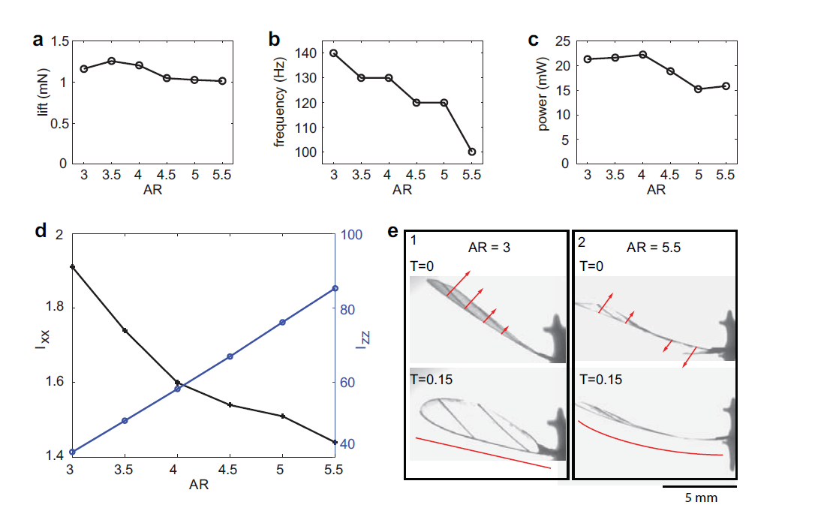
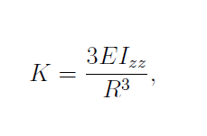
Figure 3.3: Wing aspect ratio influence on aerodynamic performance.
ƒ=1/2π √k/m
When AR increases spanwise length(R) increases
When R increased then K will decrease
If K will decrease then resonance will also decreases.

Slide 7
PARAMETER 3
First Area Moment (r̂₁) — Spanwise Mass Distribution
Definition
Key Finding
r̂₁ captures how wing area is distributed along the span. We investigate the effect of increased spanwise center of pressure.
Higher r̂₁ → area concentrated near the tip
Lower r̂₁ → area concentrated near the root
Increasing r̂₁ increases mean lift.
At r1=0.54 has resonance frequency 130 Hz. So, at 140 Hz it experience large deformation due to large aerodynamic loading.
Wing inertia changes are small (<15%) so resonance frequency is barely affected.

Slide 8
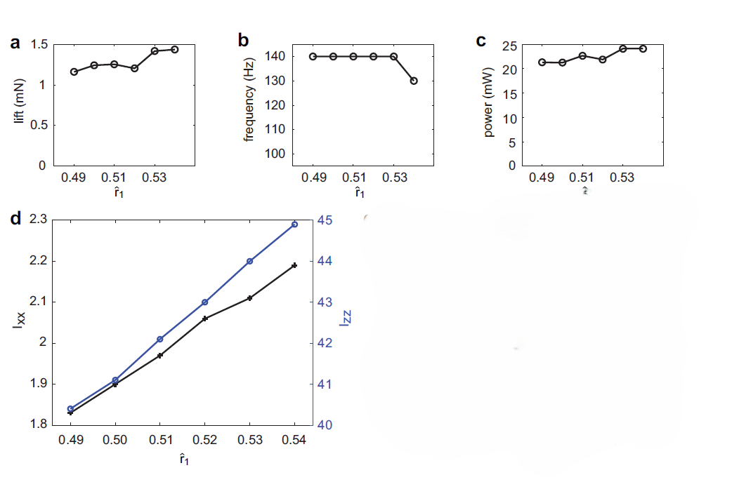
The wing with r1=0.54 is not following the trend because its motion has large stroke and pitch amplitude and consequently leads to noticeable wing deformation.
Figure 3.4: Wing area moment influence on aerodynamic performance.

Slide 9

PARAMETER 4
Leading Edge Sweep Ratio (LESR)
LESR scales the profile of the leading-edge spar. Range: 0.5 → 1.75
Positive wing leading edge sweep can facilitate the growth of the wing tip vortex that enhances lift. When we increase the LESR, it will reduce the formation of the vortex that’s why the lift decreased significantly.
Varying the LESR changes the chordwise centre of pressure, which affects wing pitching.
As the chordwise moment of inertia(Izz) is varying only a small range 40-43 that’s why the frequency is constant.

Slide 10
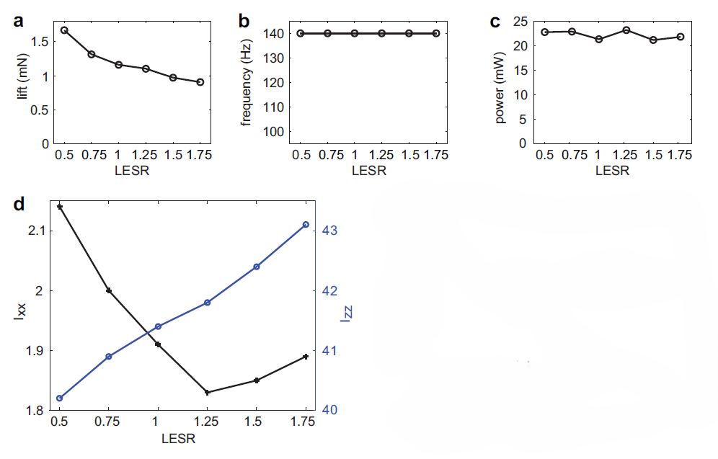
Figure 3.5: Wing leading edge sweep ratio influence on aerodynamic performance
and pitching kinematics.

Slide 11
PARAMETER 5
Wing Size
Wing size was varied by pairing different wing areas with the same actuator. Smaller wings → higher resonance → higher lift, but higher power.
f = √Keq/T^2*Izz
Resonance frequency scales inversely Izz
Izz ∝ R^4
Moment of Inertia a proportional to the R^4
f ∝ 1 / R²
Resonance frequency scales inversely with span squared
Optimised Result: 25% smaller span | 76% lower Ixx | 37% more lift | 70% more power dissipation

Slide 12
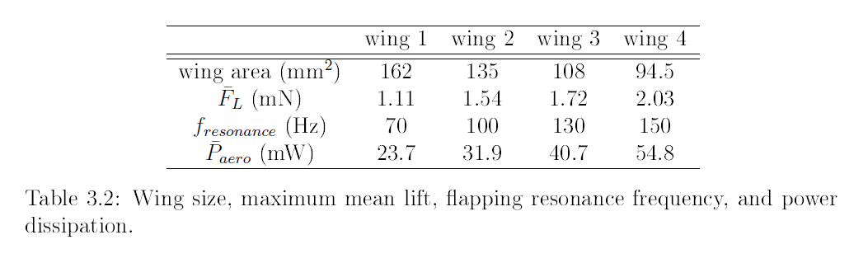

Slide 13
Conclusion :-
After studying the different parameters which affect the wing aerodynamics. We can draw the following conclusions for optimal lift.
The spar width should be around 0.23mm.
The Aspect Ratio should be around 3.5.
The First area moment of wing should be around 0.53.
The LESR should be around 0.5.
The wing size should be between 108 mm^2 to 94.5 mm^2.

Slide 14
Computational & Numerical Analysis of Different Wing Profiles

Slide 15
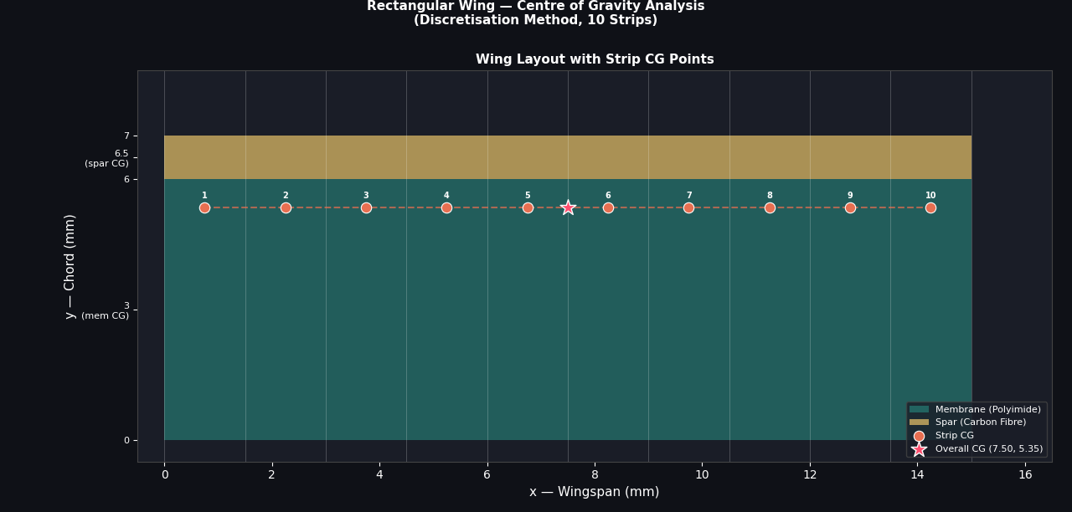
Rectangular wing profile with leading edge spar

Slide 16
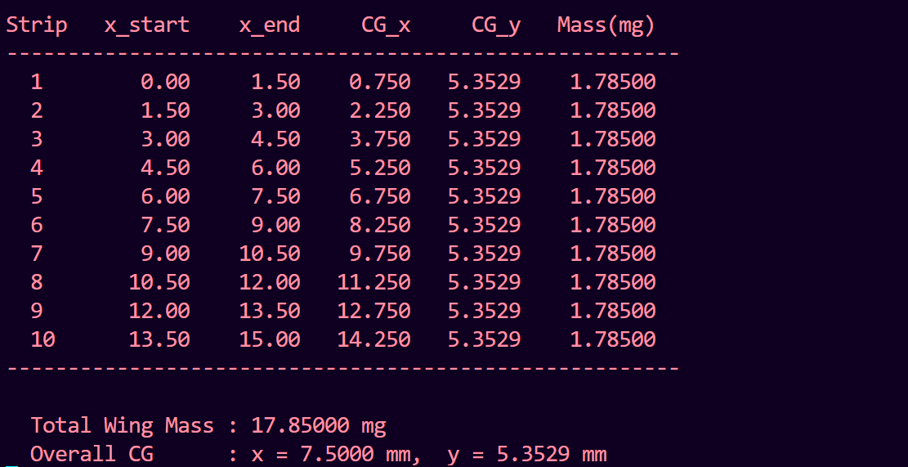
Results

Slide 17
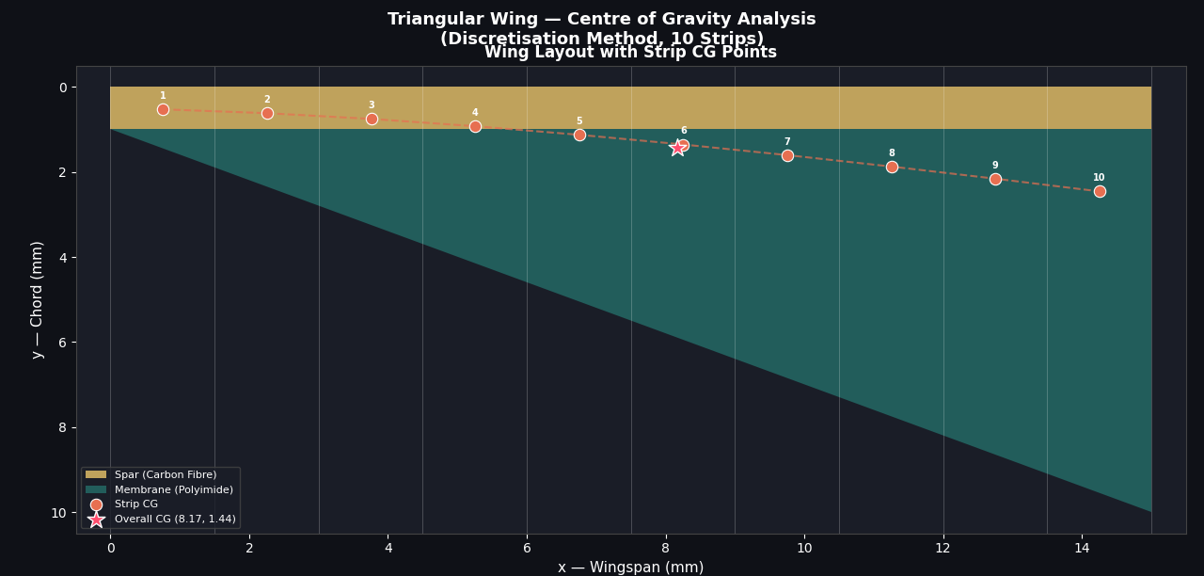
Triangular wing profile with leading edge spar

Slide 18
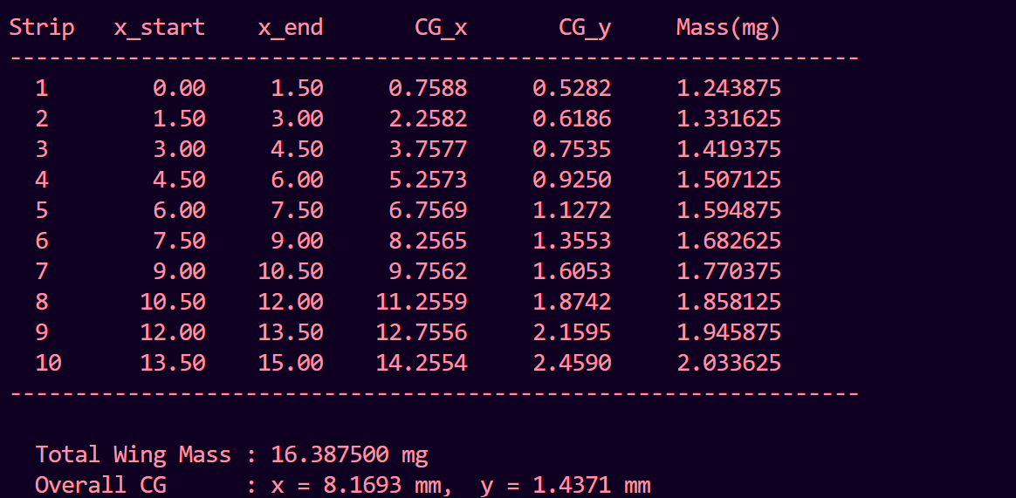
Results

Slide 19
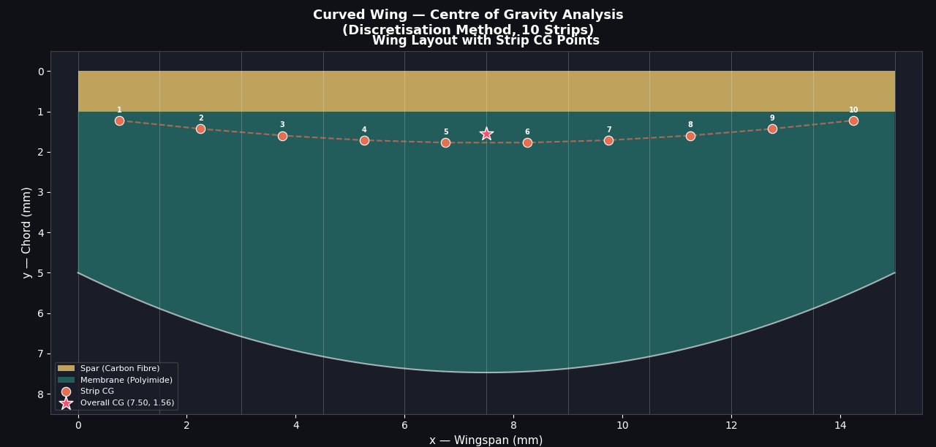
Curved wing profile with leading edge spar

Slide 20
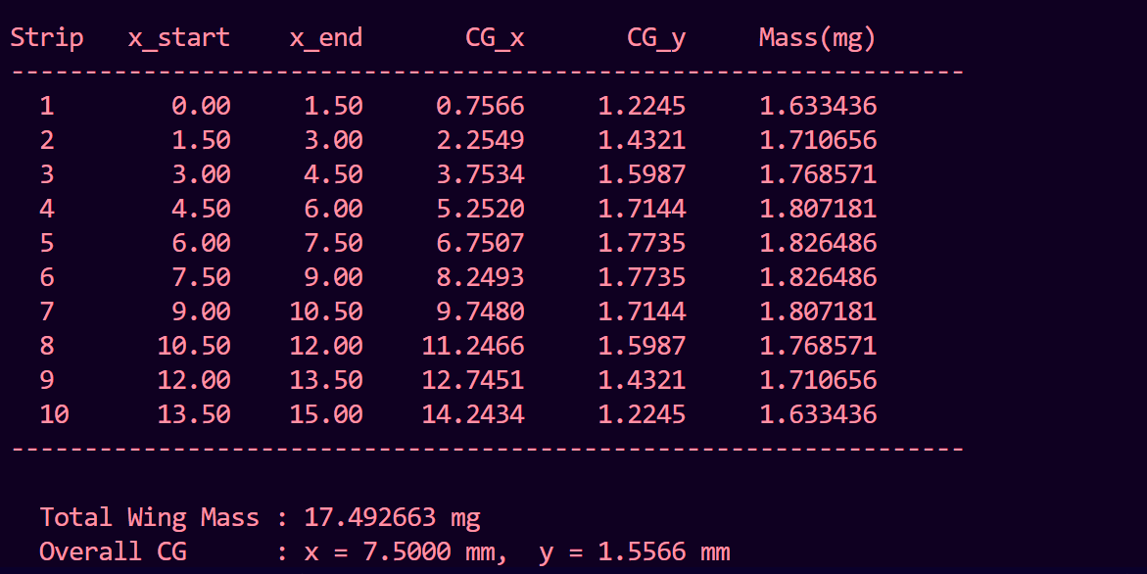
Results

Slide 21
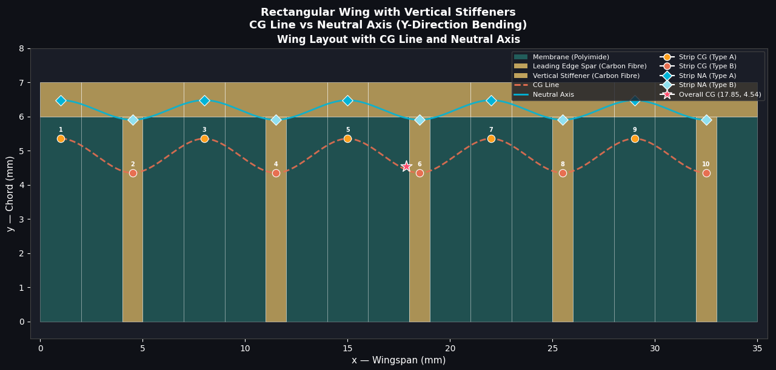
Vertically Straight carbon stiffener

Slide 22
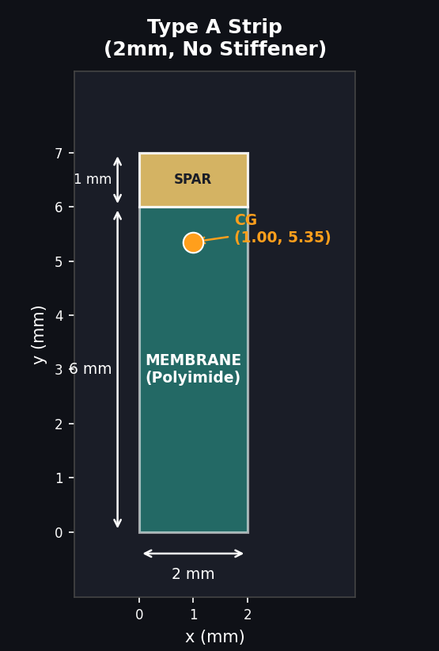
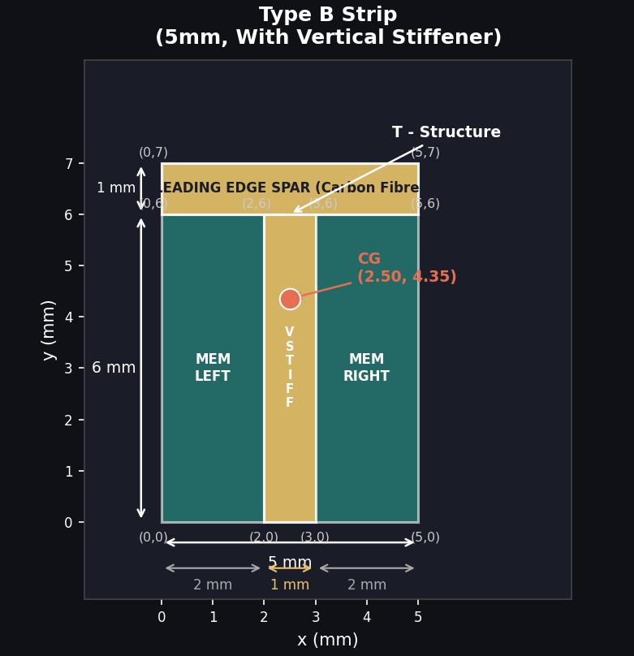







Rectangular strip with spar
Rectangular strip with vertically straight stiffener
$$X_{CG}=\frac{\sum{m_{i}x_{i}}}{Σm_{i}} Y_{CG}=\frac{\sum{m_{i}y_{i}}}{Σm_{i}}$$
$$Y_{NA}=\frac{Σ\left(E_{i}A_{i}y_{i}\right)}{Σ\left(E_{i}A_{i}\right)}$$
$$ρ_{S}=1.6$$
$$ρ_{m}=1.3$$
$$Em=5GPa E_{s}=8OGPa$$
$$t_{S}=0.5mm$$
$$t_{m}=0.05mm$$

Slide 23
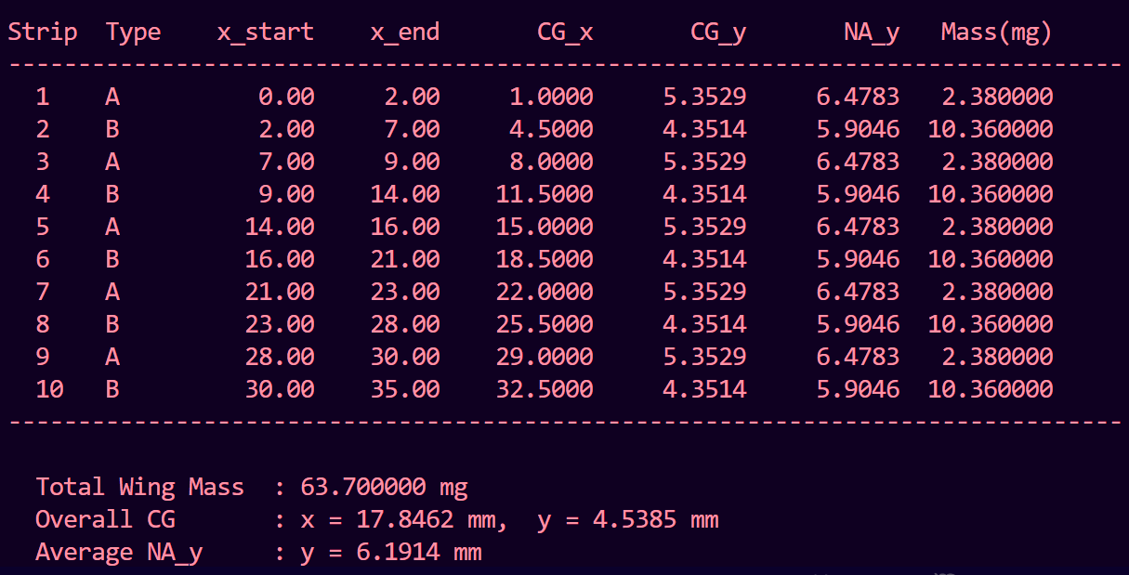
Results

Slide 24
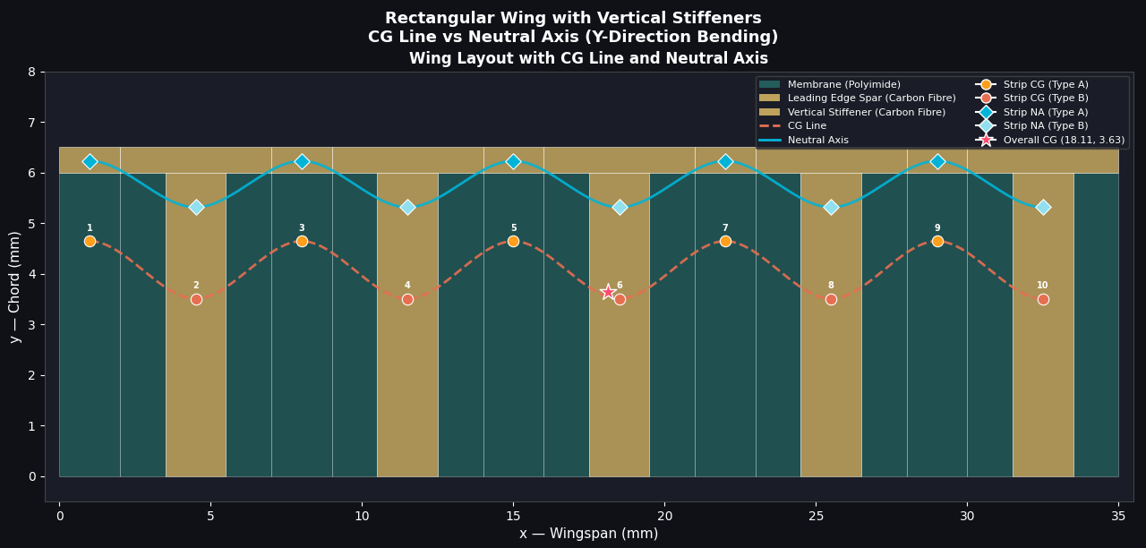
Analysis by varying spar/stiffener ratio in vertically straight stiffener wing profile
spar/stiff = 0.5/2 = 0.25

Slide 25
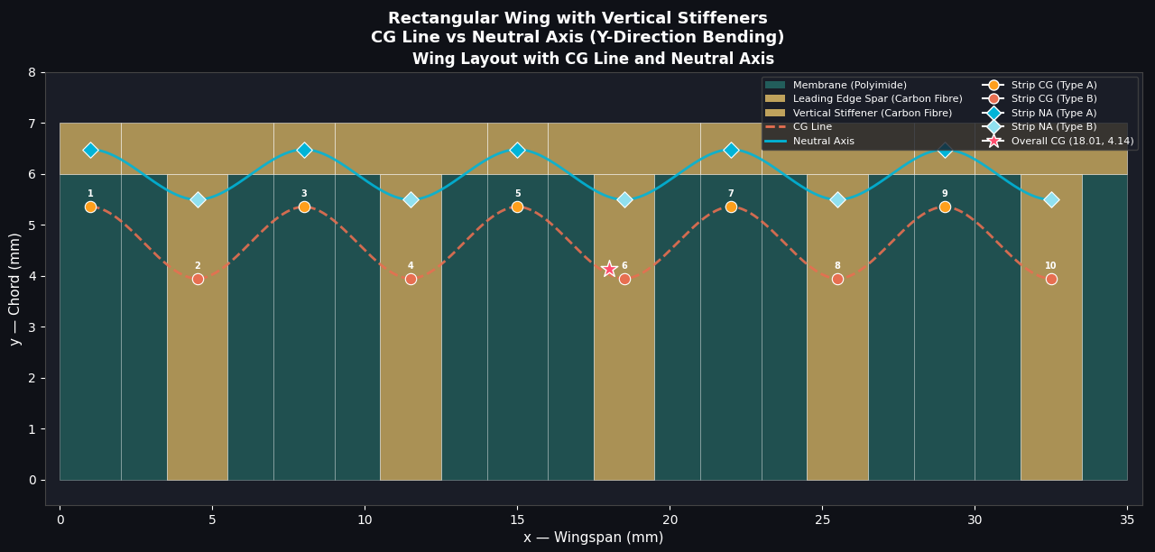
Spar/Stiff = ½ = 0.5

Slide 26
Spar/Stiff = 1/1 = 1

Slide 27
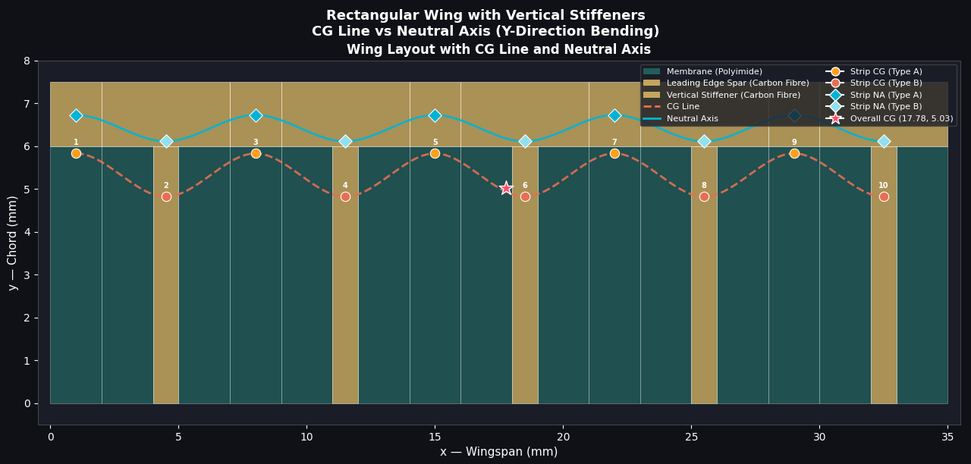
Spar/Stiff = 1.5/1 = 1.5

Slide 28
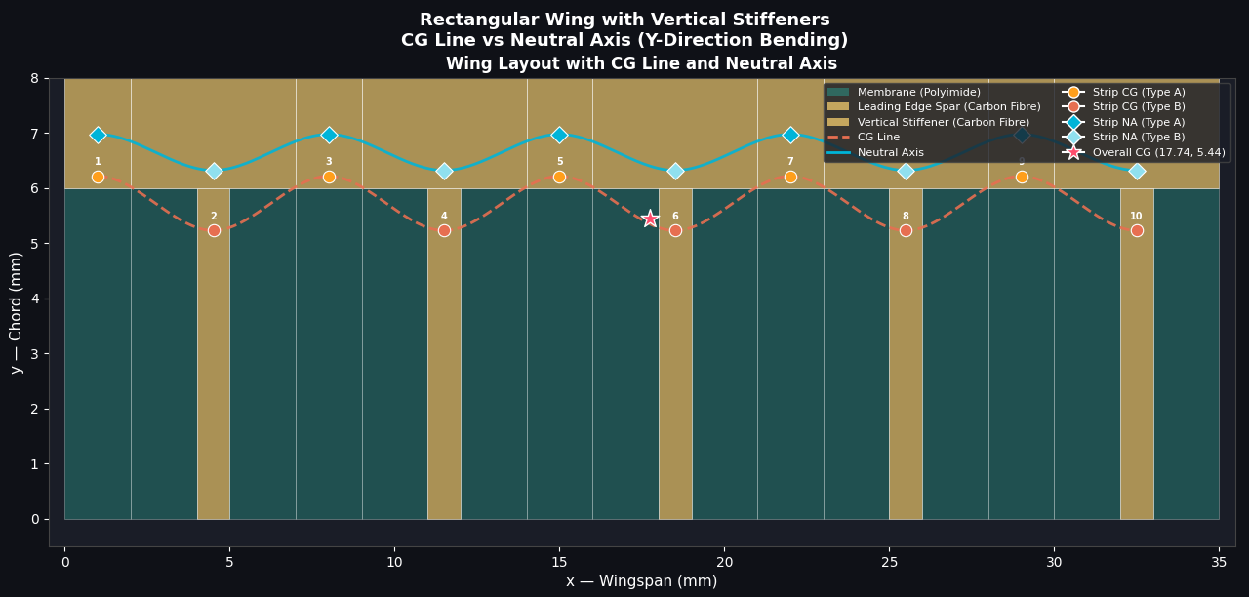
Spar/Stiff = 2/1 = 2

Slide 29
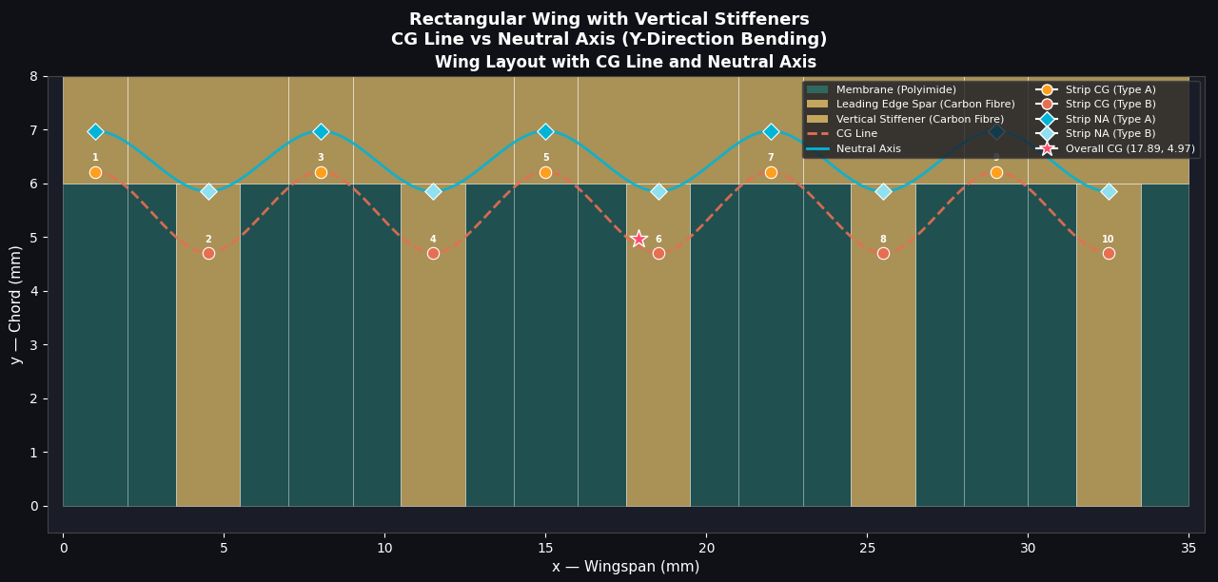
Spar/Stiff = 2/2 = 1

Slide 30
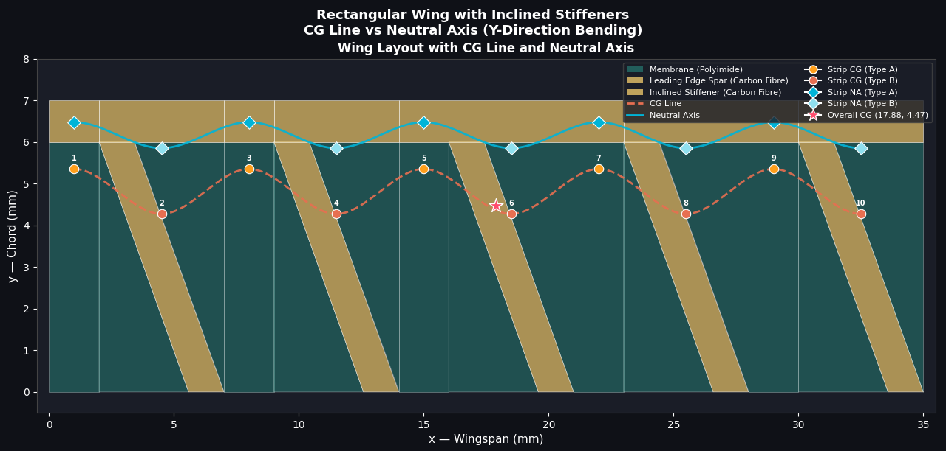
Vertically Inclined Carbon Stiffener

Slide 31
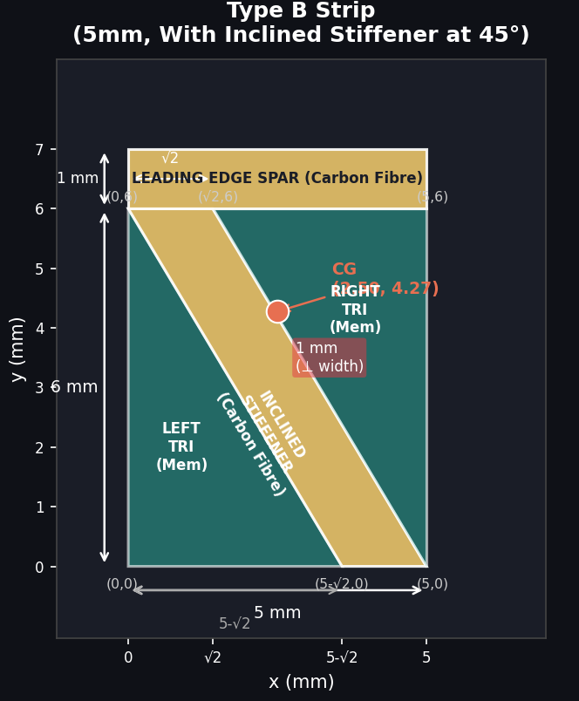
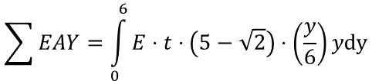
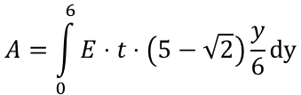
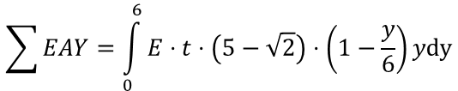
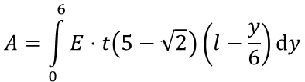
Rectangular Strip Spar
Rectangular Strip with 45˚ inclined stiffener
Left triangle
Right triangle
$$A=\int_{0}^{6}{E⋅t\left(5−\sqrt{2}\right)\left(l−\frac{y}{6}\right)ⅆy}$$
$$A=\int_{0}^{6}{E}⋅t⋅\left(5−\sqrt{2}\right)\frac{y}{6}dy$$
$$\sum{EAY}=\int_{0}^{6}{E}⋅t⋅\left(5−\sqrt{2}\right)⋅\left(1−\frac{y}{6}\right)ydy$$
$$\sum{EAY}=\int_{0}^{6}{E}⋅t⋅\left(5−\sqrt{2}\right)⋅\left(\frac{y}{6}\right)ydy$$

Slide 32
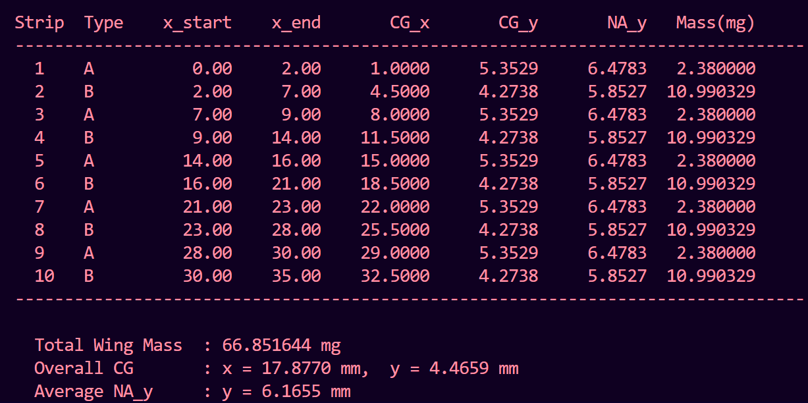
Results

Slide 33
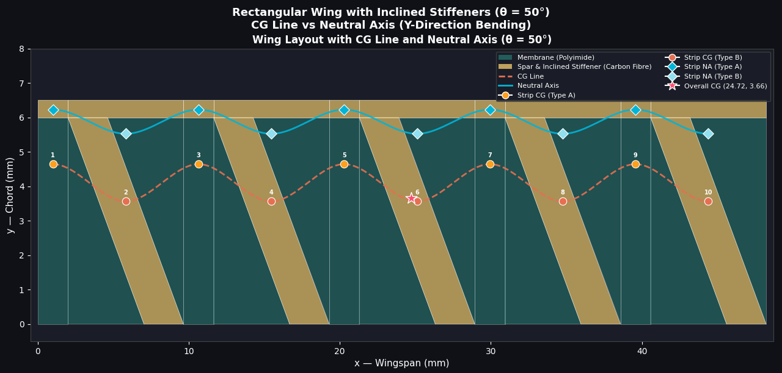
Analysis by varying spar/stiffener ratio in vertically straight stiffener wing profile
Spar/stiff = 0.5/2 = 0.25

Slide 34
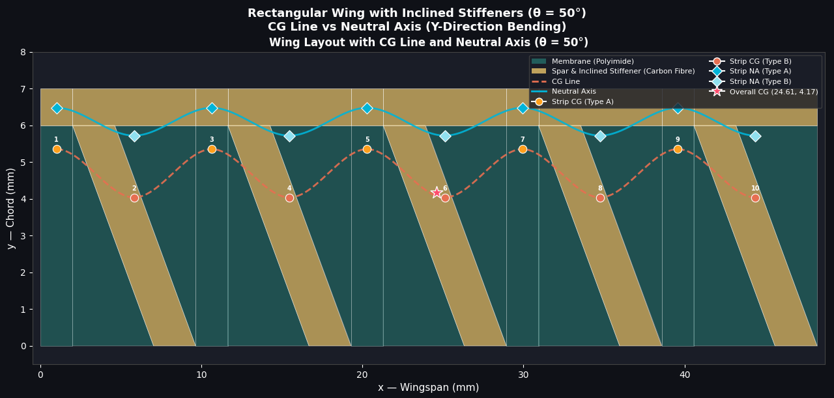
Spar/Stiff = ½ = 0.5

Slide 35
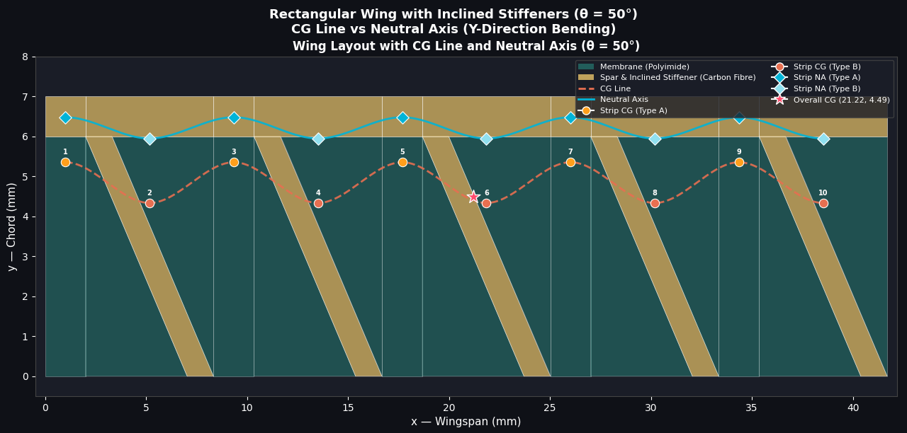
Spar/Stiff = 1/1 = 1

Slide 36
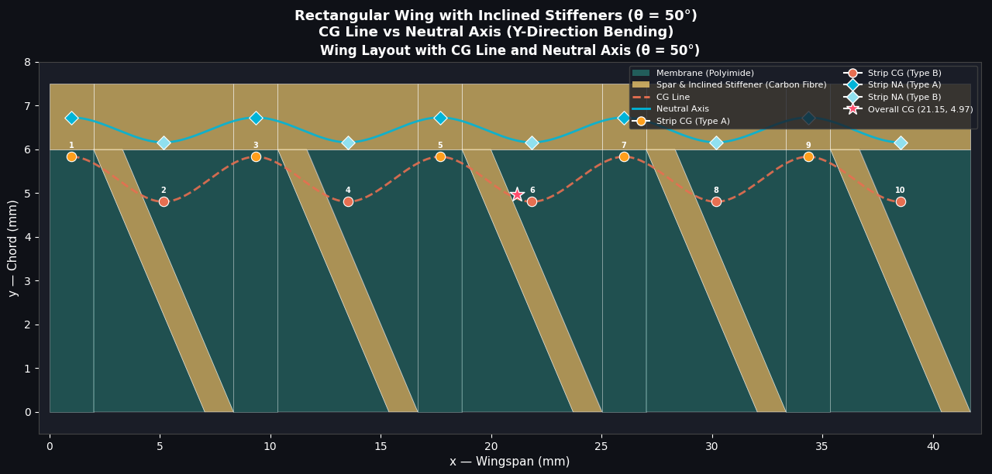
Spar/Stiff = 1.5/1 = 1.5

Slide 37
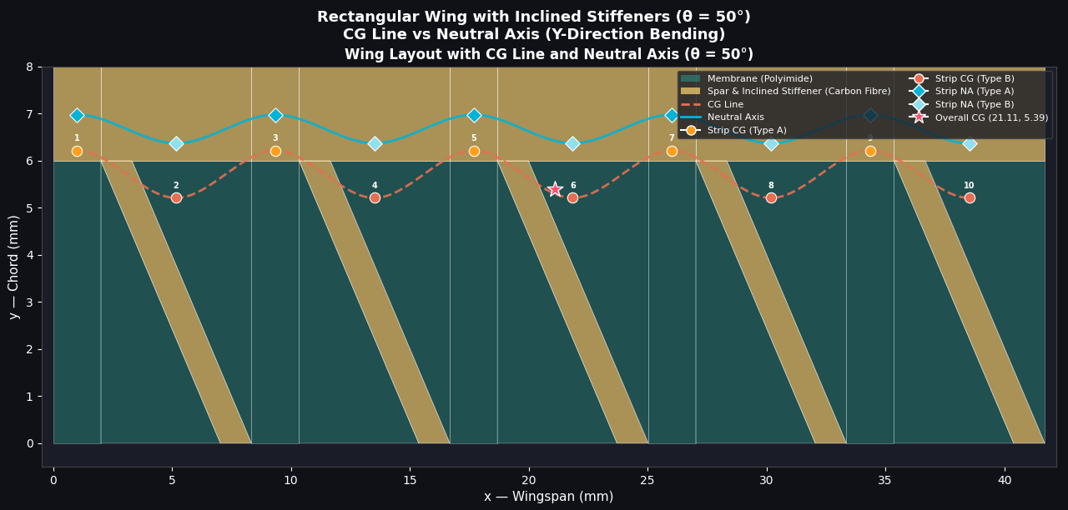
Spar/Stiff = 2/1 = 2

Slide 38
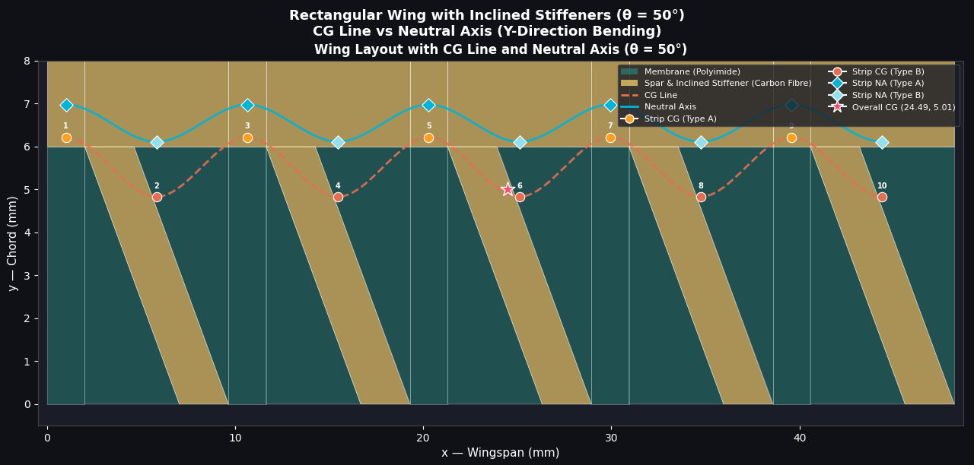
Spar/Stiff = 2/2 = 1

Slide 39
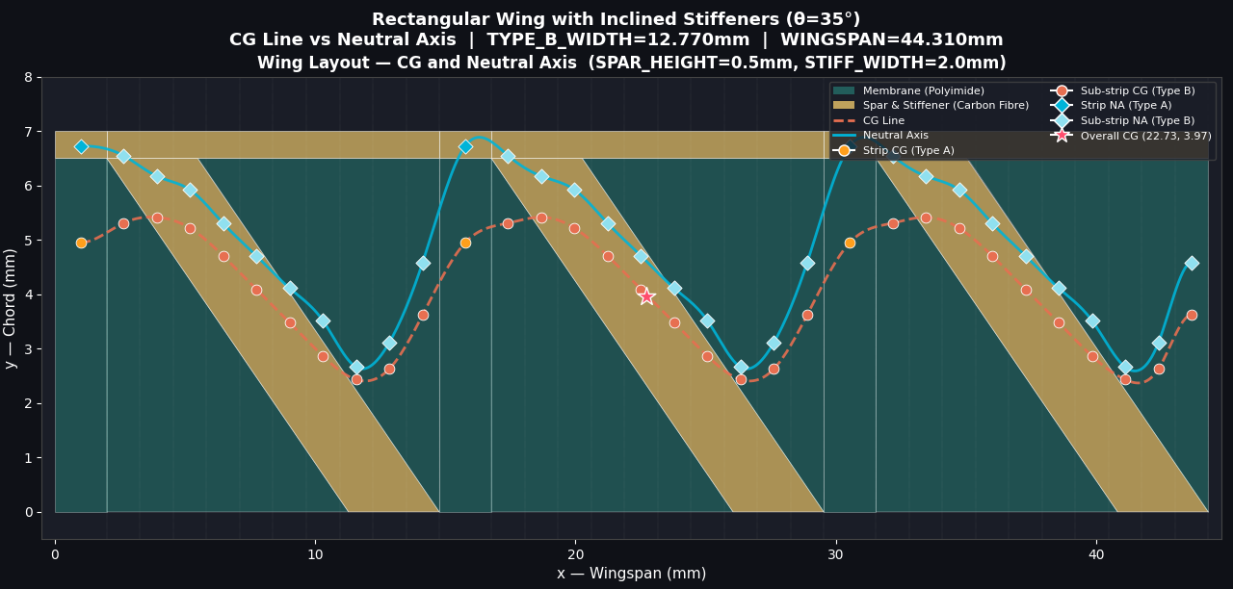
Study of Inclined rectangular strip by dividing into 10 rectangular strip
Spar/Stiff = 0.5/2.0 = 0.25

Slide 40
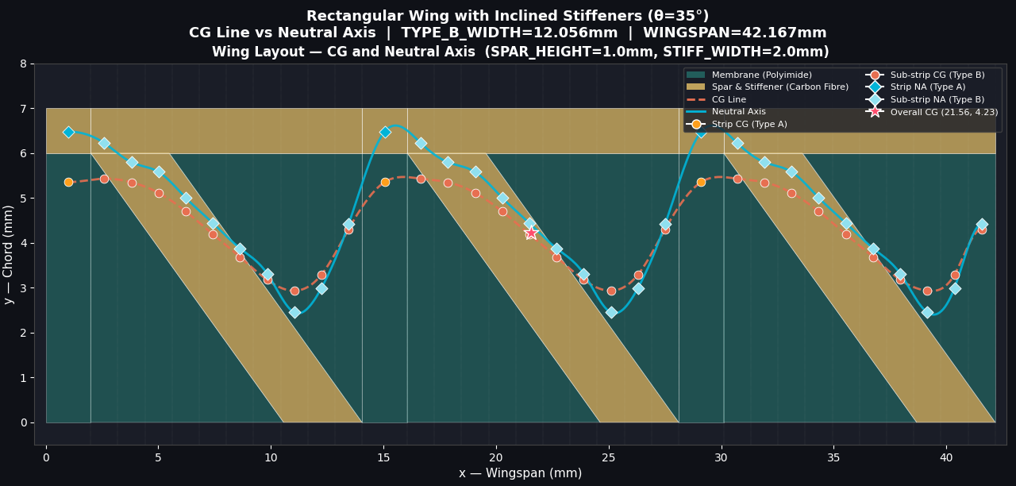
Spar/Stiff = ½ = 0.5

Slide 41
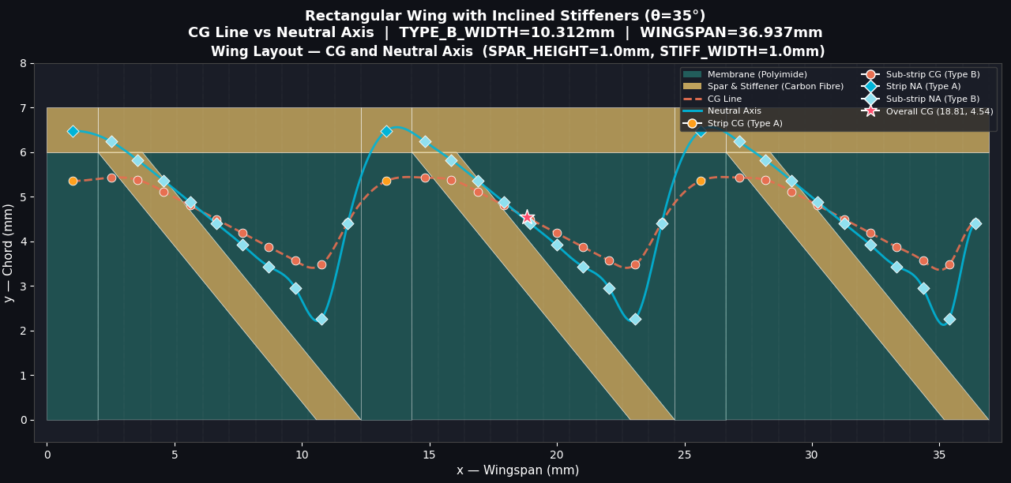
Spar/Stiff = 1/1 = 1

Slide 42
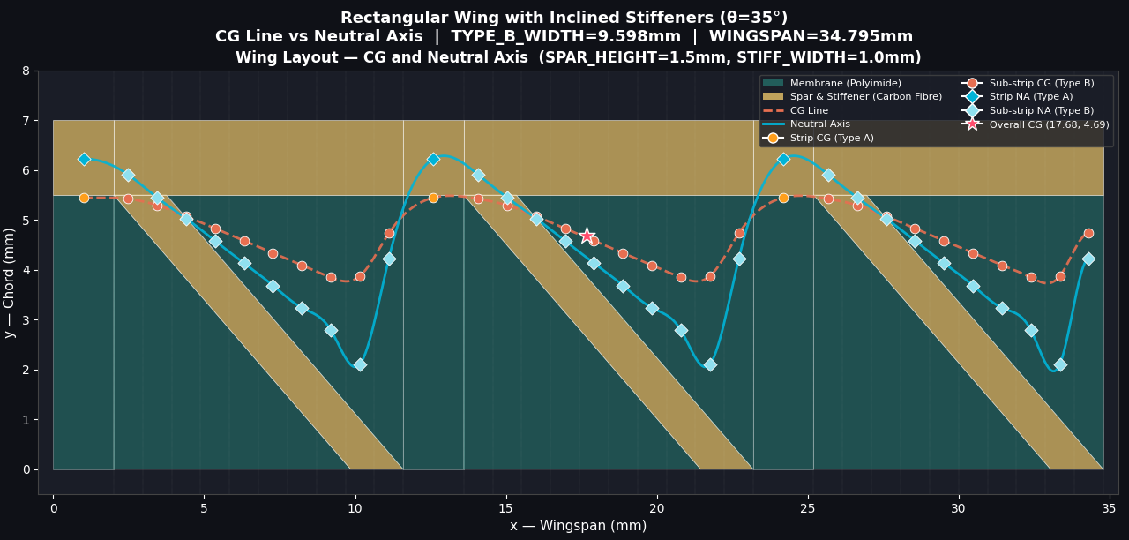
Spar/Stiff = 1.5/1 = 1.5

Slide 43
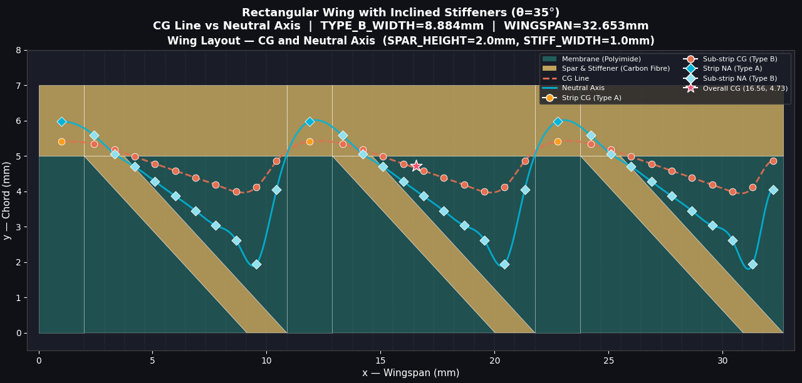
Spar/ Stiff = 2/1 = 2

Slide 44
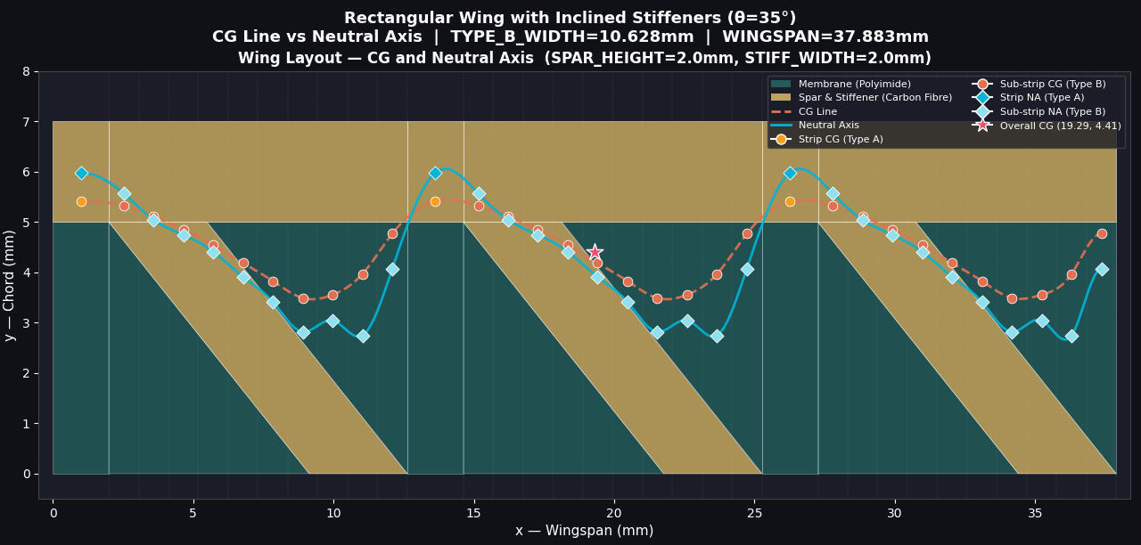
Spar/Stiff = 2/2 = 2

Slide 45
Thank You
for your time and attention
Anoop Patel | Intern Mechanical Engineering, NIT Sikkim Guide: Dr Sai Sidhardh
Reference: Y. Chen, PhD Thesis — Harvard University, 2017

